Slide 1


Welcome to Building OWL in Protégé
PIZZA.OWL
Xiaoqi Zhao
Protégé Learning Repository: https://github.com/yasenstar/protege_pizza
Protégé Pizza Tutorial: https://www.michaeldebellis.com/post/new-protege-pizza-tutorial

Slide 2


Initialize Protege
Why Protégé
Protégé at a glance
Choose proper version
Installation and initialization

Slide 3
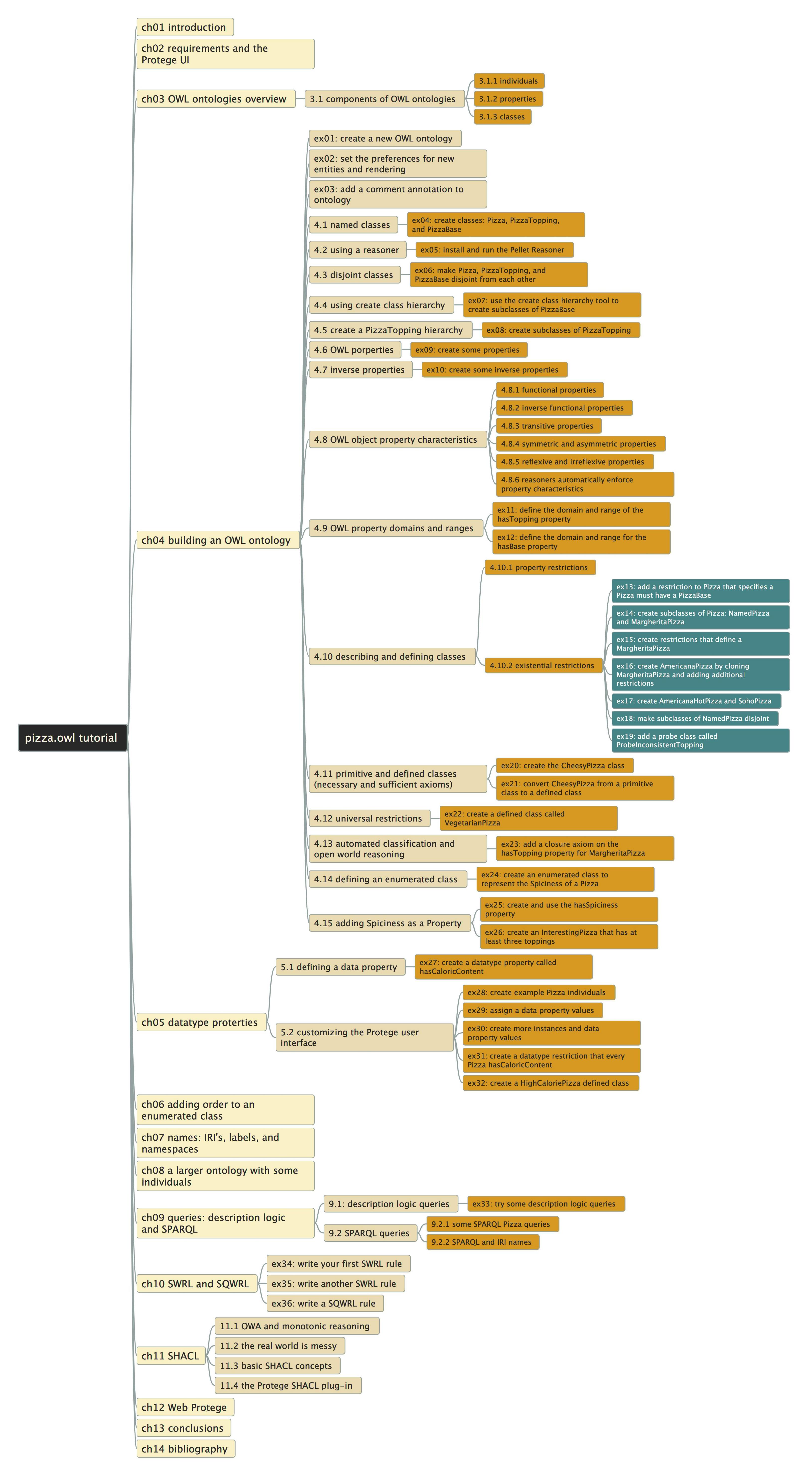
Pizza.owl Tutorial
Author: Michael DeBellis
Latest version 3.2
Learn step by step
14 chapters
36 exercises

Slide 4

Structure of Video List
Similar like my previous “ArchiSurance” and “ArchiMetal” videos
Protégé is the tool, we focus on learning ontology structure (from pizza.owl) and modeling skills (actual using Protégé)
Every video covers 1 or 1+ exercises
Github repository tracks the snapshot model file, mapping to every video
When applicable, will discuss and abstract certain modeling pattern
Goal: know protégé, know ontology from hands-on practice

Slide 5
Building OWL in Protégé
PIZZA.OWL
02 – Structure on pizza.owl case study
Xiaoqi Zhao
Protégé Learning Repository: https://github.com/yasenstar/protege_pizza
Protégé Pizza Tutorial: https://www.michaeldebellis.com/post/new-protege-pizza-tutorial

Slide 6
Building OWL in Protégé
PIZZA.OWL
03 – Initial Protégé Environment
Xiaoqi Zhao
Protégé Learning Repository: https://github.com/yasenstar/protege_pizza
Protégé Pizza Tutorial: https://www.michaeldebellis.com/post/new-protege-pizza-tutorial

Slide 7
Building OWL in Protégé
PIZZA.OWL
04 – Create New Owl Ontology (ex01,02,03)
Xiaoqi Zhao
Protégé Learning Repository: https://github.com/yasenstar/protege_pizza
Protégé Pizza Tutorial: https://www.michaeldebellis.com/post/new-protege-pizza-tutorial

Slide 8
Building OWL in Protégé
PIZZA.OWL
05 – Named Classes
(ex04)
Xiaoqi Zhao
Protégé Learning Repository: https://github.com/yasenstar/protege_pizza
Protégé Pizza Tutorial: https://www.michaeldebellis.com/post/new-protege-pizza-tutorial

Slide 9
Building OWL in Protégé
PIZZA.OWL
06 – Using a Reasoner
(ex05)
Xiaoqi Zhao
Protégé Learning Repository: https://github.com/yasenstar/protege_pizza
Protégé Pizza Tutorial: https://www.michaeldebellis.com/post/new-protege-pizza-tutorial

Slide 10
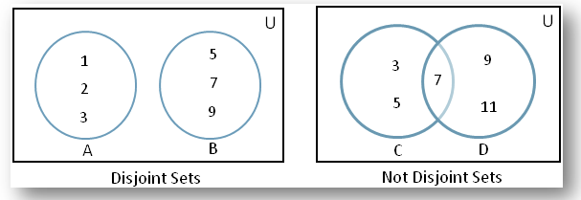
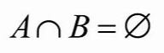
Building OWL in Protégé
PIZZA.OWL
07 – Disjoint Classes
(ex06)
Xiaoqi Zhao
Protégé Learning Repository: https://github.com/yasenstar/protege_pizza
Protégé Pizza Tutorial: https://www.michaeldebellis.com/post/new-protege-pizza-tutorial

Slide 11
Building OWL in Protégé
PIZZA.OWL
08 – Understand Ontology Model File Structure (RDF)
Xiaoqi Zhao
Protégé Learning Repository: https://github.com/yasenstar/protege_pizza
Protégé Pizza Tutorial: https://www.michaeldebellis.com/post/new-protege-pizza-tutorial

Slide 12
Building OWL in Protégé
PIZZA.OWL
09 – Using Create Class Hierarchy
(ex07, ex08)
Xiaoqi Zhao
Protégé Learning Repository: https://github.com/yasenstar/protege_pizza
Protégé Pizza Tutorial: https://www.michaeldebellis.com/post/new-protege-pizza-tutorial

Slide 13
Building OWL in Protégé
PIZZA.OWL
10 – OWL Properties
(ex09)
Xiaoqi Zhao
Protégé Learning Repository: https://github.com/yasenstar/protege_pizza
Protégé Pizza Tutorial: https://www.michaeldebellis.com/post/new-protege-pizza-tutorial

Slide 14
Building OWL in Protégé
PIZZA.OWL
11 – Inverse Properties
(ex10)
Xiaoqi Zhao
Protégé Learning Repository: https://github.com/yasenstar/protege_pizza
Protégé Pizza Tutorial: https://www.michaeldebellis.com/post/new-protege-pizza-tutorial

Slide 15
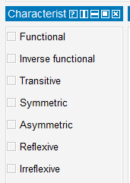
Building OWL in Protégé
PIZZA.OWL
12 – Owl Object Property Characteristics
Xiaoqi Zhao
Protégé Learning Repository: https://github.com/yasenstar/protege_pizza
Protégé Pizza Tutorial: https://www.michaeldebellis.com/post/new-protege-pizza-tutorial

Slide 16
Building OWL in Protégé
PIZZA.OWL
13 – OWL Property Domains and Ranges
(ex11/ex12)
Xiaoqi Zhao
Protégé Learning Repository: https://github.com/yasenstar/protege_pizza
Protégé Pizza Tutorial: https://www.michaeldebellis.com/post/new-protege-pizza-tutorial

Slide 17
Building OWL in Protégé
PIZZA.OWL
14 – Existential Restrictions
(ex13)
Xiaoqi Zhao
Protégé Learning Repository: https://github.com/yasenstar/protege_pizza
Protégé Pizza Tutorial: https://www.michaeldebellis.com/post/new-protege-pizza-tutorial

Slide 18
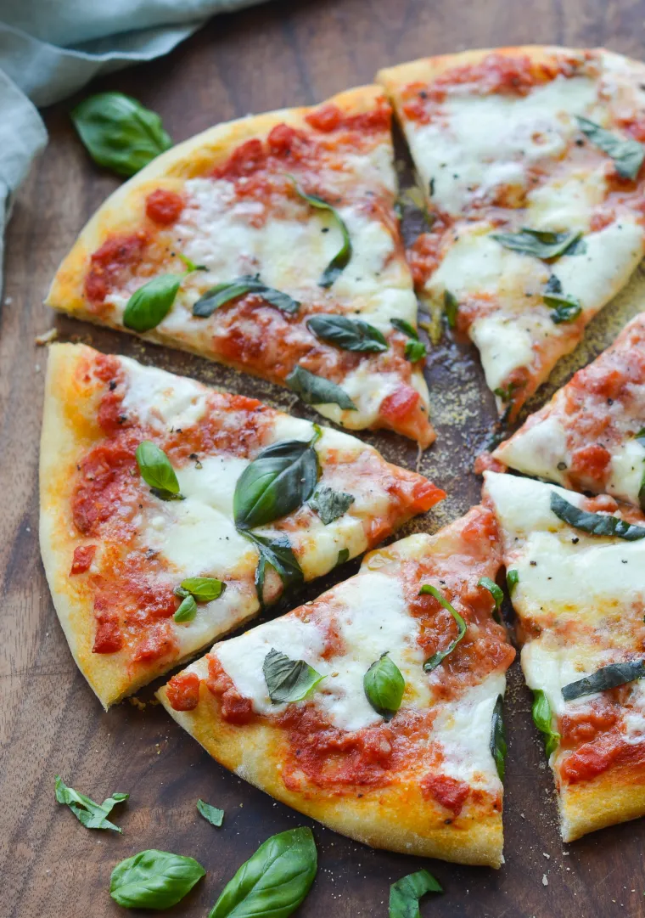
Building OWL in Protégé
PIZZA.OWL
15 – Creating Subclasses of Pizza
(ex14: NamePizza and MargheritaPizza)
Xiaoqi Zhao
Protégé Learning Repository: https://github.com/yasenstar/protege_pizza
Protégé Pizza Tutorial: https://www.michaeldebellis.com/post/new-protege-pizza-tutorial

Slide 19
Building OWL in Protégé
PIZZA.OWL
16 – Creating Subclasses of Pizza
(ex15: Create Restrictions that define a MargheritaPizza)
Xiaoqi Zhao
Protégé Learning Repository: https://github.com/yasenstar/protege_pizza
Protégé Pizza Tutorial: https://www.michaeldebellis.com/post/new-protege-pizza-tutorial

Slide 20
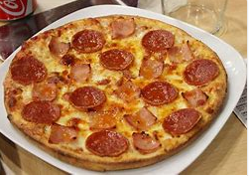
Building OWL in Protégé
PIZZA.OWL
17 – Creating Subclasses of Pizza
(ex16: Create AmericanaPizza by Cloning MargheritaPizza and Adding Additional Restrictions)
Xiaoqi Zhao
Protégé Learning Repository: https://github.com/yasenstar/protege_pizza
Protégé Pizza Tutorial: https://www.michaeldebellis.com/post/new-protege-pizza-tutorial

Slide 21


Building OWL in Protégé
PIZZA.OWL
18 – Creating Subclasses of Pizza
(ex17: Create AmericanaHotPizza and SohoPizza)
Xiaoqi Zhao
Protégé Learning Repository: https://github.com/yasenstar/protege_pizza
Protégé Pizza Tutorial: https://www.michaeldebellis.com/post/new-protege-pizza-tutorial

Slide 22
Building OWL in Protégé
PIZZA.OWL
19 – Creating Subclasses of Pizza
(ex18: Make Subclasses of NamedPizza Disjoint)
Xiaoqi Zhao
Protégé Learning Repository: https://github.com/yasenstar/protege_pizza
Protégé Pizza Tutorial: https://www.michaeldebellis.com/post/new-protege-pizza-tutorial

Slide 23
Building OWL in Protégé
PIZZA.OWL
20 – Detecting a Class that can’t Have Members
(ex19)
Xiaoqi Zhao
Protégé Learning Repository: https://github.com/yasenstar/protege_pizza
Protégé Pizza Tutorial: https://www.michaeldebellis.com/post/new-protege-pizza-tutorial

Slide 24
Building OWL in Protégé
PIZZA.OWL
21 – Primitive Classes
(ex20: Create the CheesyPizza class)
Xiaoqi Zhao
 | Primitive Classes | Defined Classes
Necessary Restrictions | ☑ | ☑
Sufficient Restrictions |  | ☑
Protégé Learning Repository: https://github.com/yasenstar/protege_pizza
Protégé Pizza Tutorial: https://www.michaeldebellis.com/post/new-protege-pizza-tutorial

Slide 25
Building OWL in Protégé
PIZZA.OWL
22 – Convert Primitive Class to Defined Class
(ex21)
Xiaoqi Zhao
Protégé Learning Repository: https://github.com/yasenstar/protege_pizza
Protégé Pizza Tutorial: https://www.michaeldebellis.com/post/new-protege-pizza-tutorial

Slide 26
Building OWL in Protégé
PIZZA.OWL
23 – Universal Restrictions
(ex22: Create a Defined Class)
Xiaoqi Zhao
Protégé Learning Repository: https://github.com/yasenstar/protege_pizza
Protégé Pizza Tutorial: https://www.michaeldebellis.com/post/new-protege-pizza-tutorial

Slide 27
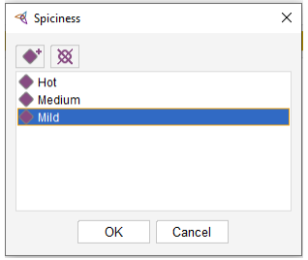
Building OWL in Protégé
PIZZA.OWL
25 – Defining an Enumerated Class
(ex24)
Xiaoqi Zhao
Protégé Learning Repository: https://github.com/yasenstar/protege_pizza
Protégé Pizza Tutorial: https://www.michaeldebellis.com/post/new-protege-pizza-tutorial

Slide 28
Building OWL in Protégé
PIZZA.OWL
24 – Automated Classification and Open World Reasoning
(ex23: Add Closure Axiom)
OWA | CWA
If a statement is not known to be true, it is not assumed to be false Knowledge is considered incomplete OWL | If there is no proof for a statement to be true, it is false Knowledge is assumed to be complete Logic programming, databases etc.
Xiaoqi Zhao
Protégé Learning Repository: https://github.com/yasenstar/protege_pizza
Protégé Pizza Tutorial: https://www.michaeldebellis.com/post/new-protege-pizza-tutorial

Slide 29
Building OWL in Protégé
PIZZA.OWL
26 – Adding Spiciness as a Property
(ex25: Create and Use the hasSpiciness Property)
Xiaoqi Zhao
Protégé Learning Repository: https://github.com/yasenstar/protege_pizza
Protégé Pizza Tutorial: https://www.michaeldebellis.com/post/new-protege-pizza-tutorial

Slide 30
Building OWL in Protégé
PIZZA.OWL
27 – Cardinality Restrictions
(ex26: Create an Interesting Pizza that has at least three toppings)
Xiaoqi Zhao
Protégé Learning Repository: https://github.com/yasenstar/protege_pizza
Protégé Pizza Tutorial: https://www.michaeldebellis.com/post/new-protege-pizza-tutorial

Slide 31
Building OWL in Protégé
PIZZA.OWL
28 – Defining a Data Property (ex27)
OWL | UML OOP | E-R Model
Object Property | Association | Relation
Datatype Property | Attribute | Attribute
Xiaoqi Zhao
Protégé Learning Repository: https://github.com/yasenstar/protege_pizza
Protégé Pizza Tutorial: https://www.michaeldebellis.com/post/new-protege-pizza-tutorial

Slide 32
Building OWL in Protégé
PIZZA.OWL
29 – Customize Protégé UI
(ex28: Create Example Pizza Individuals
ex29: Assign a Data Property Values)
Xiaoqi Zhao
Protégé Learning Repository: https://github.com/yasenstar/protege_pizza
Protégé Pizza Tutorial: https://www.michaeldebellis.com/post/new-protege-pizza-tutorial

Slide 33
Building OWL in Protégé
PIZZA.OWL
30 – Customize Protégé UI
(ex30: Create More Instance and Data Property Values)
Xiaoqi Zhao
Protégé Learning Repository: https://github.com/yasenstar/protege_pizza
Protégé Pizza Tutorial: https://www.michaeldebellis.com/post/new-protege-pizza-tutorial

Slide 34
Building OWL in Protégé
PIZZA.OWL
31 – Customize Protégé UI
(ex31: Create a Datatype Restriction)
Xiaoqi Zhao
Protégé Learning Repository: https://github.com/yasenstar/protege_pizza
Protégé Pizza Tutorial: https://www.michaeldebellis.com/post/new-protege-pizza-tutorial

Slide 35
Building OWL in Protégé
PIZZA.OWL
32 – Customize Protégé UI
(ex32: Create a HighCaloriePizza Defined Class)
Xiaoqi Zhao
Protégé Learning Repository: https://github.com/yasenstar/protege_pizza
Protégé Pizza Tutorial: https://www.michaeldebellis.com/post/new-protege-pizza-tutorial

Slide 36
Building OWL in Protégé
PIZZA.OWL
33 – Adding Order to an Enumerated Class
Xiaoqi Zhao
Protégé Learning Repository: https://github.com/yasenstar/protege_pizza
Protégé Pizza Tutorial: https://www.michaeldebellis.com/post/new-protege-pizza-tutorial

Slide 37
Building OWL in Protégé
PIZZA.OWL
34 – Chapter 7 Names: IRI’s, Labels, and Namespaces
Xiaoqi Zhao
Protégé Learning Repository: https://github.com/yasenstar/protege_pizza
Protégé Pizza Tutorial: https://www.michaeldebellis.com/post/new-protege-pizza-tutorial

Slide 38
Building OWL in Protégé
PIZZA.OWL
35 – Chapter 8
A Larger Ontology with some Individuals
Xiaoqi Zhao
Protégé Learning Repository: https://github.com/yasenstar/protege_pizza
Protégé Pizza Tutorial: https://www.michaeldebellis.com/post/new-protege-pizza-tutorial

Slide 39
Building OWL in Protégé
PIZZA.OWL
36 – Chapter 9 Queries
(ex33: Try Some Description Logic Queries)
Xiaoqi Zhao
Protégé Learning Repository: https://github.com/yasenstar/protege_pizza
Protégé Pizza Tutorial: https://www.michaeldebellis.com/post/new-protege-pizza-tutorial

